Slide 1
CS1010X Lecture 3:
Wishful Thinking,
Good Abstractions,
&
Intro to Recursion (wishful thinking again?)
Notes:
Lecture 3a video

Slide 2
Quick Review
Lecture 1: get to know Python
Lecture 2: solve with a single function / abstraction
Lecture 3: solve with many functions…
Managing Complexity…
Dealing with primitive and abstraction

Slide 3
Managing Complexity
(Part 1 of 3)

Slide 4
Abstractions
Primitives
Problem
Solution
Abstractions
Invented to make task easier
Lecture 2: using picture language with
- Primitive
Combinations of primitives
Abstraction of combinations
Abstraction of abstraction, and so on

Slide 5
Wishful Thinking
Top-down approach
pretend you have
whatever you need

Slide 6
Suppose we want a function to compute hypothenuse of a
right angle triangle
def hypotenuse(a,b):
return sqrt(sum_of_squares(a,b))
def sum_of_squares(x,y):
return square(x) + square(y)
def square(x):
return x * x
?
a
b

Slide 7
Another Example
NTUC Comfort, the largest taxi operator in Singapore, determines the taxi fare based on distance traveled as follows:
For the first kilometre or less: $3.00
Every 400 metres thereafter or less up to 10 km: $0.22
Every 350 metres thereafter or less after 10 km: $0.22
Problem: Write a Python program that computes the taxi fare from the distance traveled

Slide 8
How to
start?

Slide 9
Formulate the problem
taxi_fare
distance
fare

Slide 10
How to
proceed?

Slide 11
How can the result be computed from data?
  Try simple examples
  Strategize step by step
  Write it down and refine
  “it” : abstraction, codes, etc.
  Repeat the above till fully complete

Slide 12
1. Try simple examples
e.g.#1: distance = 800 m,
fare = $3.00
e.g.#2: distance = 3300 m,
fare = $3.00 + roundup(2300/400) × $0.22
= $4.32
e.g.#3: distance = 14500 m,
fare = $3.00 + roundup(9000/400) × $0.22 +
roundup(4500/350)× $0.22
= $10.92

Slide 13
2. Strategize step by step
Pseudocode
Case 1: distance <= 1,000
fare = $3.00
Case 2: 1000 < distance <= 10,000
fare = $3.00 + $0.22 * roundup( (distance – 1,000)/ 400)
Case 3: distance > 10,000
fare = $8.06 + $0.22 * roundup( (distance – 10,000)/ 350)
Note: the Python function ceil rounds up its argument math.ceil(1.5) = 2
What’s this?
fare for 10 km

Slide 14
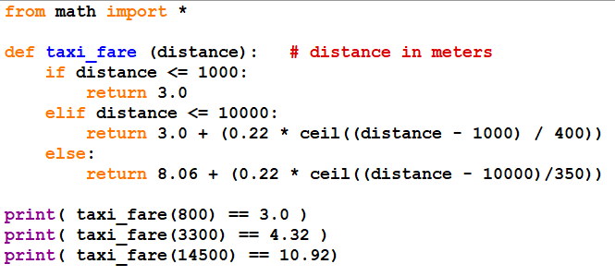
3. Write it down and refine
Any “problem with the above code?
If yes, can we improve it?

Slide 15
Avoid Magic Numbers
It is a terrible idea to hardcode constants (magic numbers):
  Hard to make changes in future
E.g. What if starting fare is increased to $3.2?
Define abstractions to hide them!

Slide 16
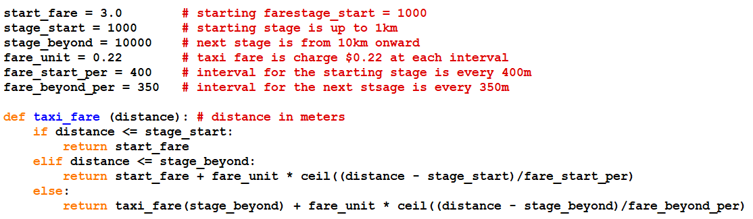
3. Write it down and refine
Refining…

Slide 17
3. Write it down and refine
How does wishful thinking work here…
taxi_fare
taxi_fare_start_fare
taxi_fare_stage_start
taxi_fare_stage_beyond

Slide 18
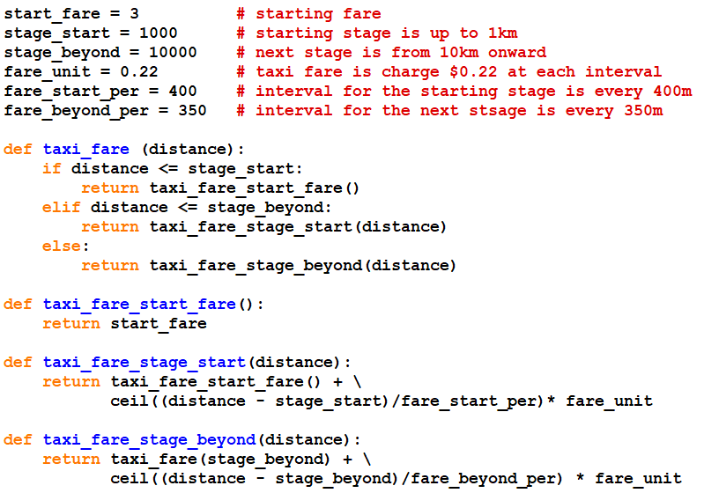
3. Write it down and refine

Slide 19
Wishful Thinking
Summary:
PROBLEM
Top-down
SUB-
PROBLEM 1
SUB-
PROBLEM 2
……
Key Insight:
Smaller problems are
easier to solve / manage
SUB-SUB
PROBLEM 3
SUB-SUB
PROBLEM 4
……

Slide 20
Managing Complexity
(Part 2 of 3)
Notes:
Lecture 3b video

Slide 21
Abstractions
Primitives
Problem
Solution
Abstractions
Invented to make task easier
What makes a good abstraction?

Slide 22
Good Abstraction
Consideration:
Make it more natural to think about (sub)-tasks
Make programs easier to understand
Capture common patterns
Allow for code re-use
Hide irrelevant details
Separate specification from implementation
Make debugging (fixing error) easier
We will summarize all these into a few keywords
to remember when solving computational problem

Slide 23
Good Abstraction
1. Make it more natural to think about (sub)-tasks
2. Make programs easier to understand
3. Capture common patterns
4. Allow for code re-use
5. Hide irrelevant details
6. Separate specification from implementation
7. Make debugging (fixing error) easier
House
Bricks?
Program
Primitives
Functions
Rooms
Primitives
Bricks

Slide 24
Good Abstraction
1. Make it more natural to think about (sub)-tasks
2. Make programs easier to understand
3. Capture common patterns
4. Allow for code re-use
5. Hide irrelevant details
6. Separate specification from implementation
7. Make debugging (fixing error) easier
Compare:
def hypotenuse(a, b):
return sqrt(sum_of_squares(a, b))
def sum_of_squares(x, y):
return square(x) + square(y)
def square(x):
return x * x
Versus:
def hypotenuse(a, b):
return sqrt((a*a) + (b*b))
Versus:
def hypotenuse(a, b):
def square(x):
return x * x
return sqrt( square(x) + square(x) )

Slide 25
Good Abstraction
1. Make it more natural to think about (sub)-tasks
2. Make programs easier to understand
3. Capture common patterns
4. Allow for code re-use
5. Hide irrelevant details
6. Separate specification from implementation
7. Make debugging (fixing error) easier
stack(
beside(
quarter_turn_right(rcross_bb),
turn_upside_down(rcross_bb)),
beside(
rcross_bb,
quarter_turn_left(rcross_bb)))
def make_cross(pic):
pic
pic
pic
pic
Allows Code Reuse

Slide 26
Good Abstraction
1. Make it more natural to think about (sub)-tasks
2. Make programs easier to understand
3. Capture common patterns
4. Allow for code re-use
5. Hide irrelevant details
6. Separate specification from implementation
7. Make debugging (fixing error) easier
Function square used in sum_of_squares.
square can also be used in calculating area of circle.
Area of circle, given its radius:
pi = 3.14159
def circle_area_from_radius(r):
return pi * square(r)
Area from diameter:
def circle_area_from_diameter(d):
return circle_area_from_radius(d/2)

Slide 27
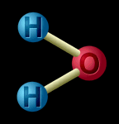
Good Abstraction
1. Make it more natural to think about (sub)-tasks
2. Make programs easier to understand
3. Capture common patterns
4. Allow for code re-use
5. Hide irrelevant details
6. Separate specification from implementation
7. Make debugging (fixing error) easier
depth map
STEREOGRAM
GENERATOR
  water molecule represented as 3 balls
stereogram
  Okay for some chemical analyses, inadequate for others.

Slide 28
Good Abstraction
1. Make it more natural to think about (sub)-tasks
2. Make programs easier to understand
3. Capture common patterns
4. Allow for code re-use
5. Hide irrelevant details
6. Separate specification from implementation
7. Make debugging (fixing error) easier
def square(x):
return x * x
>>> square(2)
4
>>> square(3)
9
from math import *
def square(x):
return exp(2 * (log(x)))
>>> square(2)
4.0
>>> square(3)
9.000000000000002
No need to know how a car works
to drive it – a “black box” !
Specification: WHAT
Implementation: HOW
Why in different ways?

Slide 29
Good Abstraction
1. Make it more natural to think about (sub)-tasks
2. Make programs easier to understand
3. Capture common patterns
4. Allow for code re-use
5. Hide irrelevant details
6. Separate specification from implementation
7. Make debugging (fixing error) easier
Where is the bug?
  def hypotenuse(a, b):
  return sqrt((a + a) * (b + b))
  def hypotenuse(a,b):
  return sqrt(sum_of_squares(a,b))
  def sum_of_squares(x, y):
  return square(x) + square(y)
  def square(x): return x + x

Slide 30
Good Abstraction
1. Make it more natural to think about (sub)-tasks
2. Make programs easier to understand
3. Capture common patterns
4. Allow for code re-use
5. Hide irrelevant details
6. Separate specification from implementation
7. Make debugging (fixing error) easier
Summary to manage complexity:
1. Information Hiding with abstraction (part 2)
2. Avoid coupling with good coherence
3. Top-down design with wishful thinking (part 1)
Same (design) principles appear in object oriented design

Slide 31
Managing Complexity
(Part 3 of 3)
back to wishful thinking?
Notes:
Lecture 3c video

Slide 32
Recursion
Smaller child problem(s) has the same structure as the parent

Slide 33
Have we seen that before?

Slide 34

Lecture 2: picture language
n-1 levels
n-1 levels
base case
n levels

Slide 35
Have we seen that before?
Part 1: taxi_fare
base
cases

Slide 36
Another Example
Consider the factorial function:
n! = n x (n-1) x (n-2) … x1
Rewrite:
n! = 1 if n = 1
= n x (n-1)! if n > 1

Slide 37
Factorial
n! = 1 if n = 1
= n x (n-1)! if n > 1
def factorial(n):
if (n == 1):
return 1
else:
return n * factorial(n – 1)

Slide 38
Recursion
def factorial(n):
if (n == 1):
return 1
else:
return (n *
factorial(n – 1))
Function that calls itself is called a recursive function
terminating condition
or
base case
recursive call

Slide 39
Recursive process
n
need answer from
have answer now
n - 1
need answer from
have answer now
n - 2
need answer from
have answer now
2
need answer from
Answer is trivial!
terminating condition
1

Slide 40
Recursive process
n
need answer from
have answer now
n - 1
need answer from
have answer now
n - 2
need answer from
have answer now
2
need answer from
terminating condition
1

Slide 41
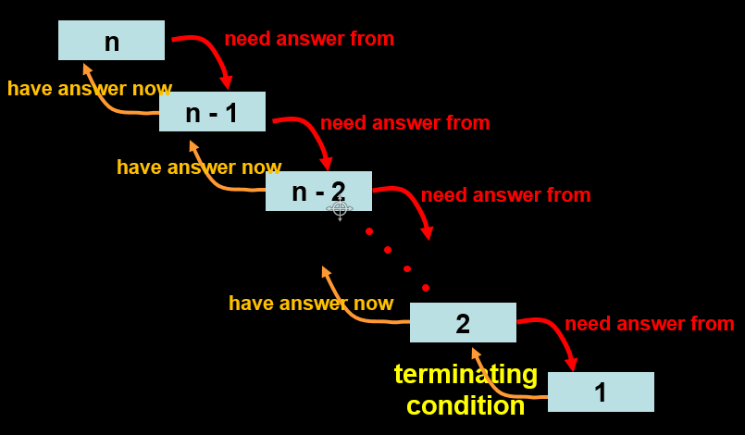
Recursive process
factorial(6)
6 * factorial(5)
6 * 5 * factorial(4)
6 * 5 * 4 * factorial(3)
6 * 5 * 4 * 3 * factorial(2)
6 * 5 * 4 * 3 * 2 * factorial(1)
6 * 5 * 4 * 3 * 2 * 1
6 * 5 * 4 * 3 * 2
6 * 5 * 4 * 6
6 * 5 * 24
6 * 120
720
Note the build up of pending operations.

Slide 42
Analysis of solution:
Time: how long it takes
Space: how much memory do we need
Time & space
complexity

Slide 43
Recursive process
factorial(6)
6 * factorial(5)
6 * 5 * factorial(4)
6 * 5 * 4 * factorial(3)
6 * 5 * 4 * 3 * factorial(2)
6 * 5 * 4 * 3 * 2 * factorial(1)
6 * 5 * 4 * 3 * 2 * 1
6 * 5 * 4 * 3 * 2
6 * 5 * 4 * 6
6 * 5 * 24
6 * 120
720
Time ∝ #operations
Linearly proportional to n

Slide 44
Recursive process
factorial(6)
6 * factorial(5)
6 * 5 * factorial(4)
6 * 5 * 4 * factorial(3)
6 * 5 * 4 * 3 * factorial(2)
6 * 5 * 4 * 3 * 2 * factorial(1)
6 * 5 * 4 * 3 * 2 * 1
6 * 5 * 4 * 3 * 2
6 * 5 * 4 * 6
6 * 5 * 24
6 * 120
720
Space ∝ # pending operations
Linearly proportional to n

Slide 45
Recursion
Figure out what’s the base case
  Typically n=0 or n=1
Assume you know how to solve the problem for n-1. (wishful thinking)
How can you use this information to solve the problem for n?

Slide 46
Yet Another Example
Fibonacci numbers
Leonardo Pisano Fibonacci (12th century)
is credited for the sequence:
0, 1, 1, 2, 3, 5, 8, 13, 21, …
Each number in the sequence (except the first two) is simply the sum of the previous two.

Slide 47
Fibonacci numbers
Fibonnacci numbers can be expressed as following:
f(n) = 0 if n = 0
= 1 if n = 1
= f(n-1) + f(n-2) if n > 1

Slide 48
Fibonacci in Python
f(n) = 0 if n = 0
= 1 if n = 1
= f(n-1) + f(n-2) if n > 1
def fib(n):
if (n == 0):
return 0
elif (n == 1):
return 1
else:
return fib(n - 1) + fib(n - 2)

Slide 49
Tree recursion
root
fib 5
fib 4
internal
nodes
fib 3
fib 3
fib 2
fib 2
fib 1
fib 1
fib 1
fib 0
fib 1
fib 0
1
fib 2
1
1
0
1
0
fib 1
fib 0
1
0
leaves

Slide 50
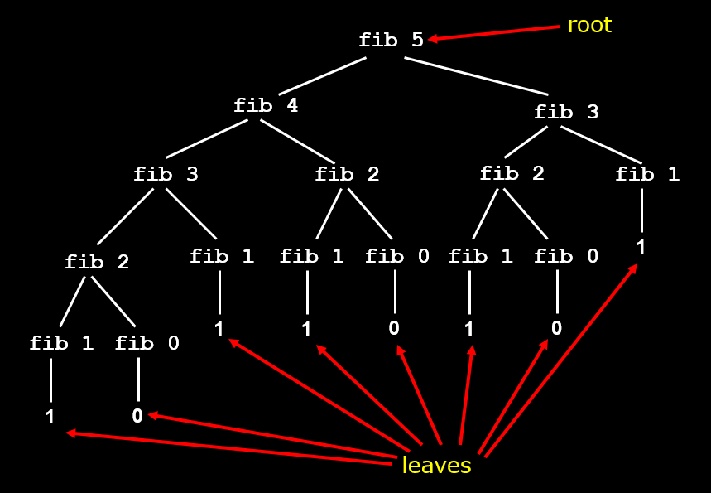
Tree recursion - Time
Number of leaves in tree is fib(n+1).
fib(n) = Φ^{n}/(√5)
  where Φ = (1 + √5)/2 ≈ 1.6180 called the golden ratio
Thus, time taken is ≈ Φ^{n} (exponential in n)

Slide 51
Tree recursion - Space
Space (memory) required is proportional to the depth of the tree i.e. linear in n
1.
11.
2.
8.
12.
15.
3.
7.
9.
10.
13.
14.
4.
5.
6.

Slide 52
Types of
Recursion

Slide 53
Linear recursion
def factorial(n):
if (n == 1):
return 1
else:
return n * factorial(n – 1)
(factorial 4)
(factorial 3)
(factorial 2)
(factorial 1)
Linear recursive function only makes a single call
to itself each time the function runs

Slide 54
Exponential recursion
def fib(n):
if (n == 0):
return 0
elif (n == 1):
return 1
else:
return fib(n - 1) + fib(n - 2)
Exponential recursive is one that, if you were to draw
out a representation of all the function calls, would have
an exponential number of calls

Slide 55
Mutual recursion
def ping(n):
if (n == 0):
return n
else:
print("Ping!")
pong(n - 1)
def pong(n):
if (n == 0):
return n
else:
print("Pong!")
ping(n - 1)
>>> ping(10)
Ping!
Pong!
Ping!
Pong!
Ping!
Pong!
Ping!
Pong!
Ping!
Pong!
A recursive function does not necessarily need to call itself.
Some recursive functions work in pairs or even larger groups.

Slide 56
Part 1: taxi_fare

Slide 57
Recursion :
- Base cases : how they are finally solved
- Smaller problems : how their solutions are combined
Summary
Recursion as a form of wishful thinking:
- Smaller problems has the same structure
as the original problem

